Slide 1
WMDA Global trends report 2022
WMDA Search & Match Service

Slide 2
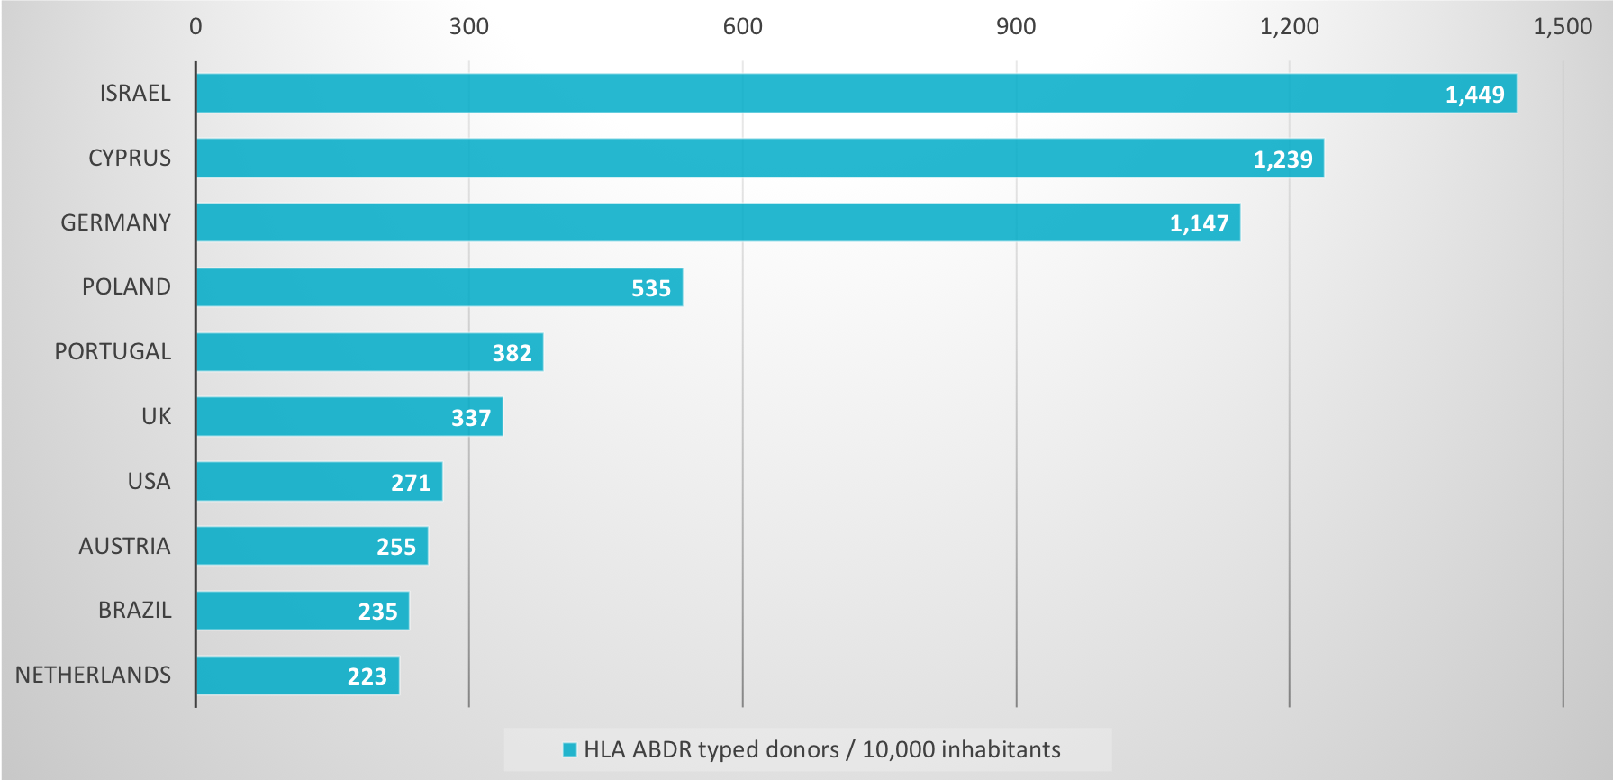
Unrelated donors listed per 10,000 inhabitants (country, top 10)
WMDA Search & Match Service 2022

Slide 3
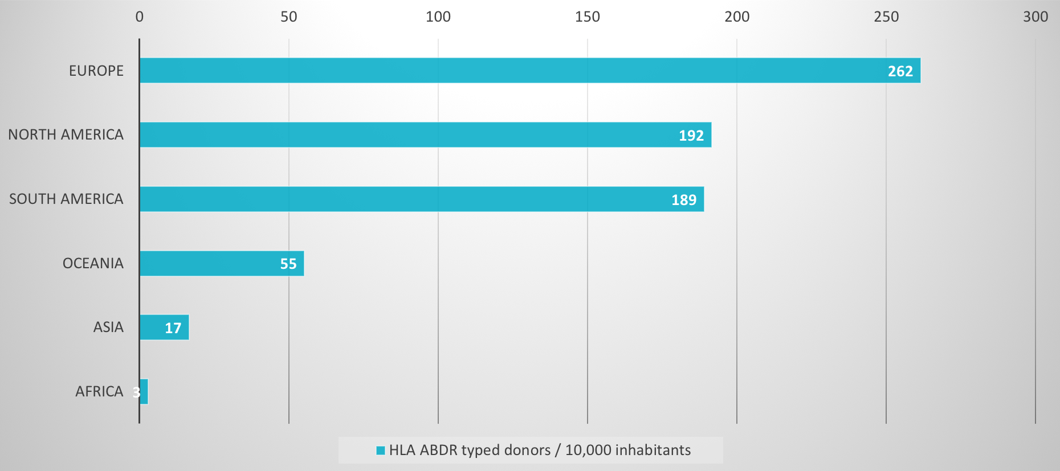
Unrelated donors listed per 10,000 inhabitants (continent)
WMDA Search & Match Service 2022

Slide 4
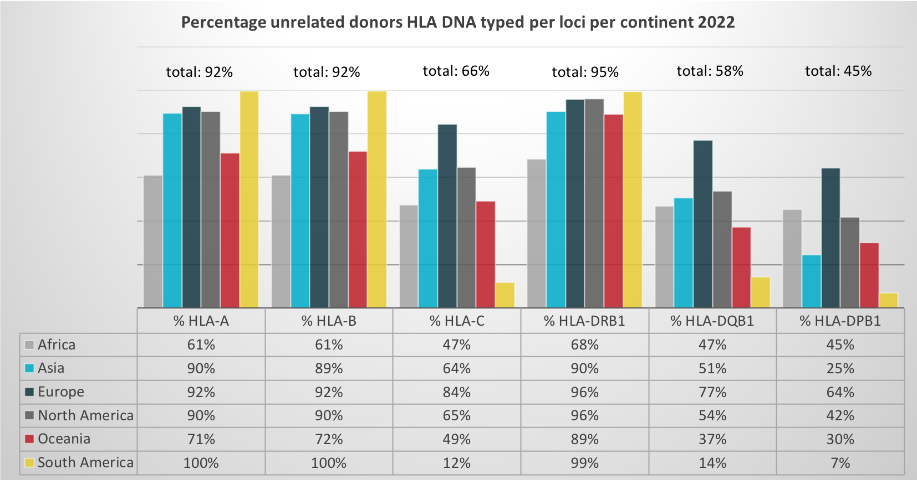
Percentage HLA DNA typed unrelated donors (per loci)
WMDA Search & Match Service 2022

Slide 5
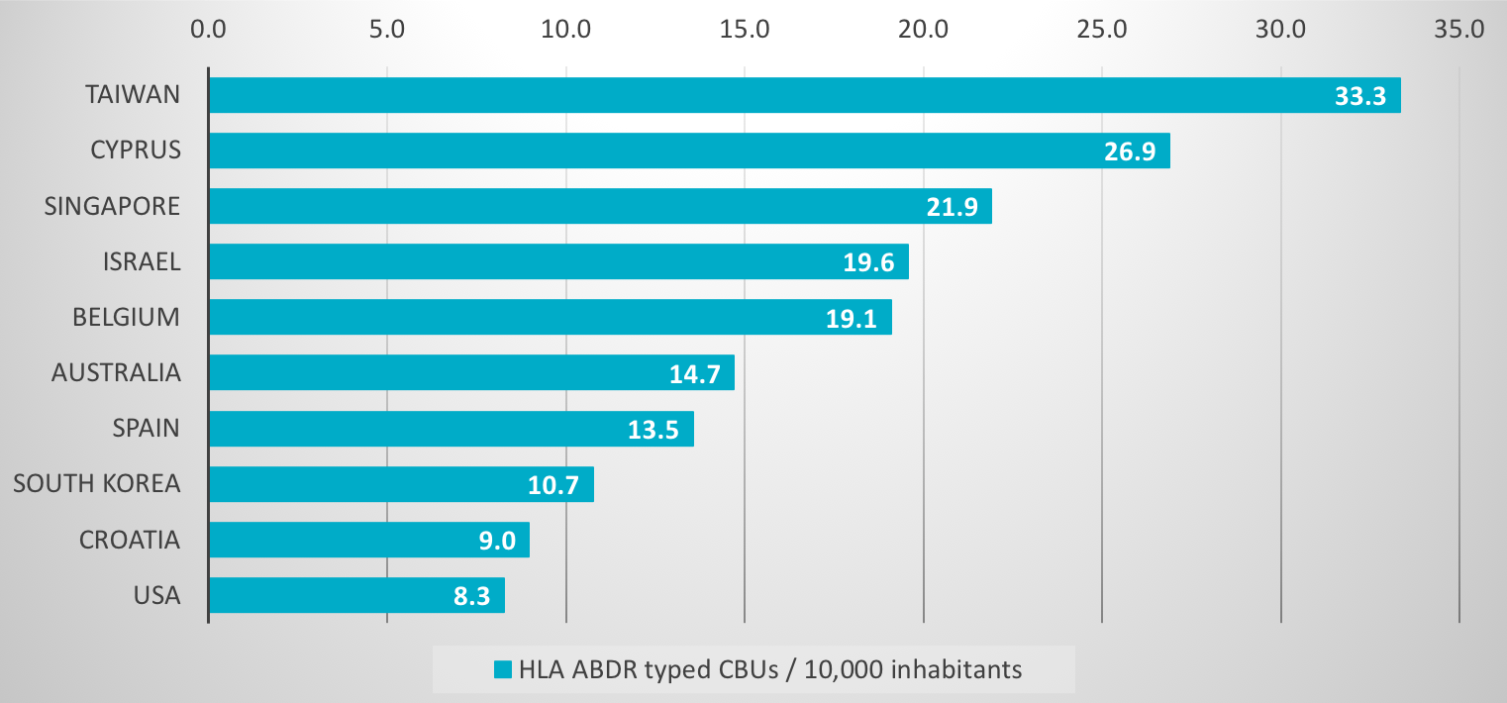
Cord blood units listed per 10,000 inhabitants (country, top 10)
WMDA Search & Match Service 2022

Slide 6
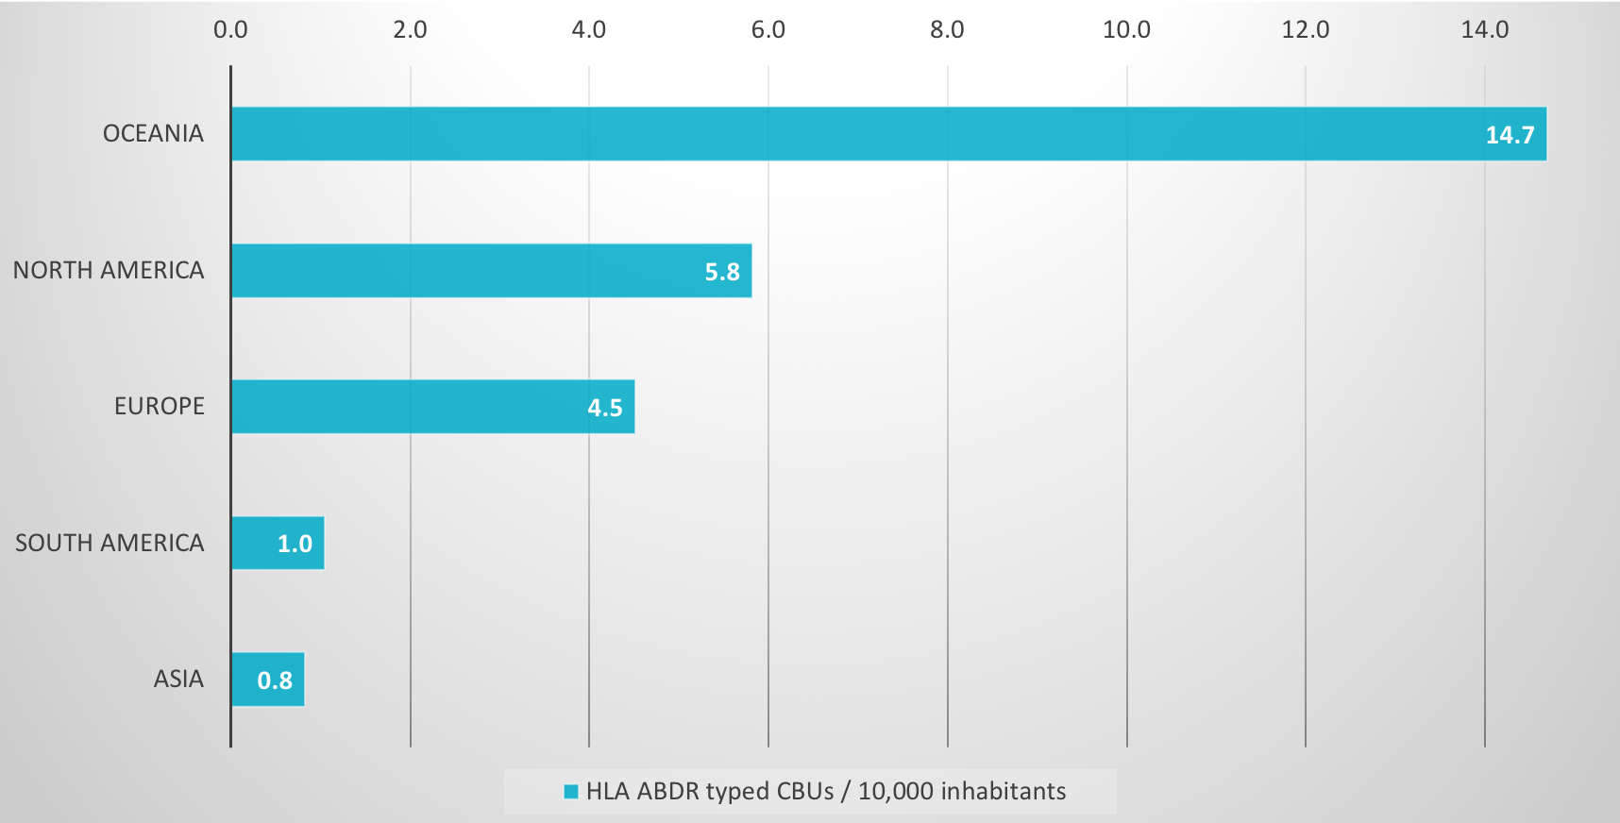
Cord blood units listed per 10,000 inhabitants (continent)
WMDA Search & Match Service 2022

Slide 7
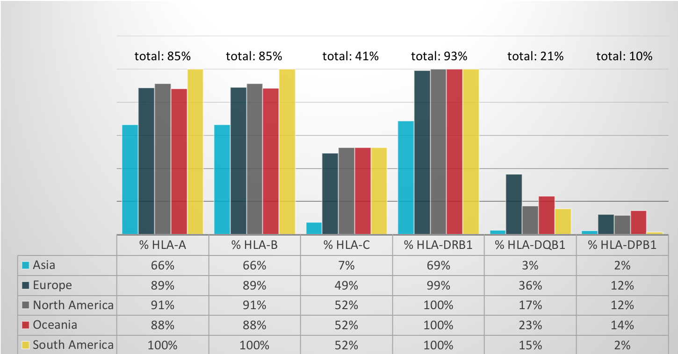
Percentage HLA DNA typed cord blood units (per loci)
WMDA Search & Match Service 2022

Slide 8
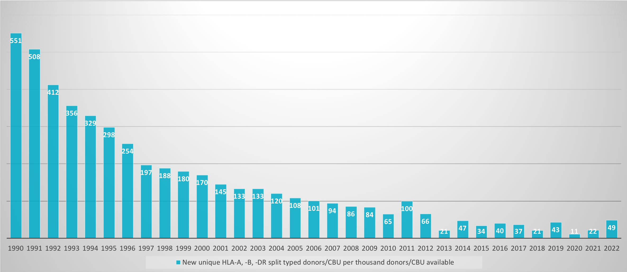
Unique HLA ABDR split unrelated donors/cord blood units added
WMDA Search & Match Service 2022

Slide 9
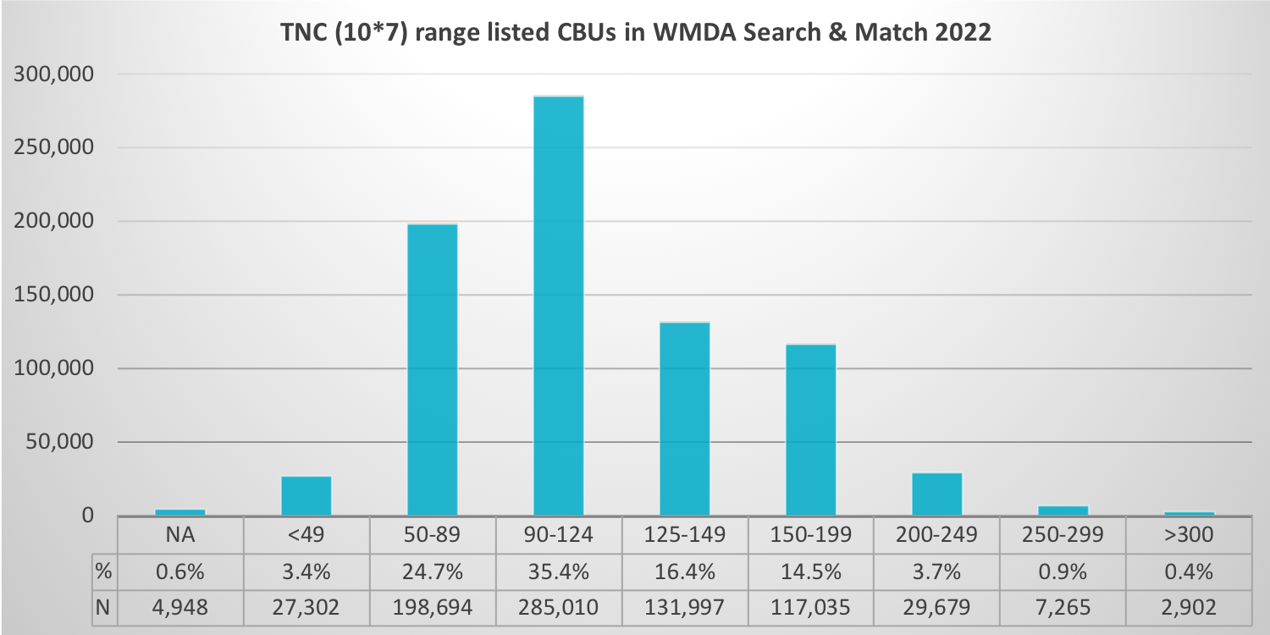
TNC range (10*7) of listed cord blood units
WMDA Search & Match Service 2022

Slide 10
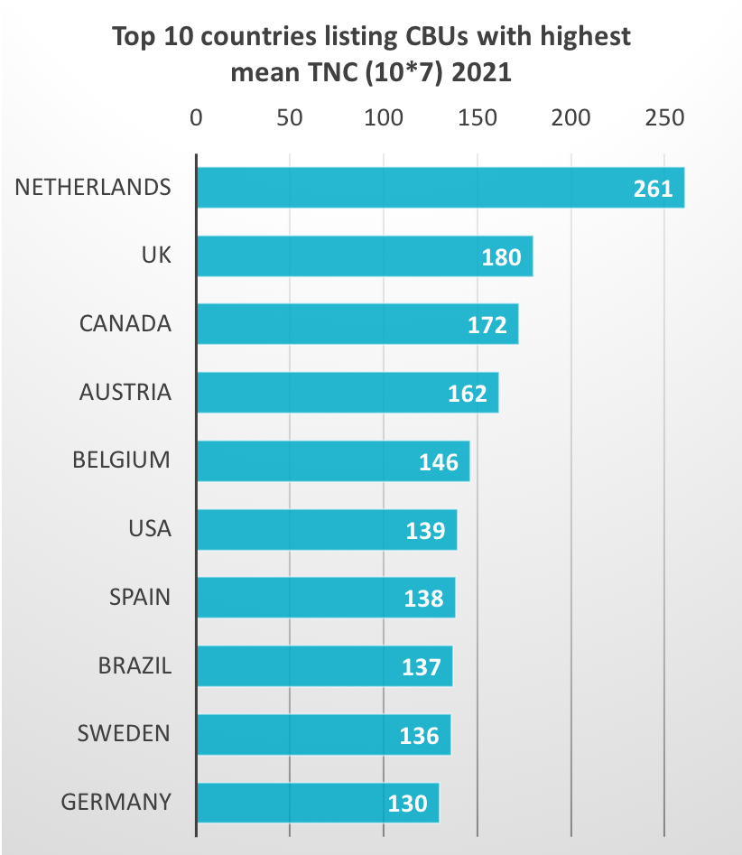
Mean TNC (10*7) of listed cord blood units (country, top 10)
WMDA Search & Match Service 2022

Slide 11
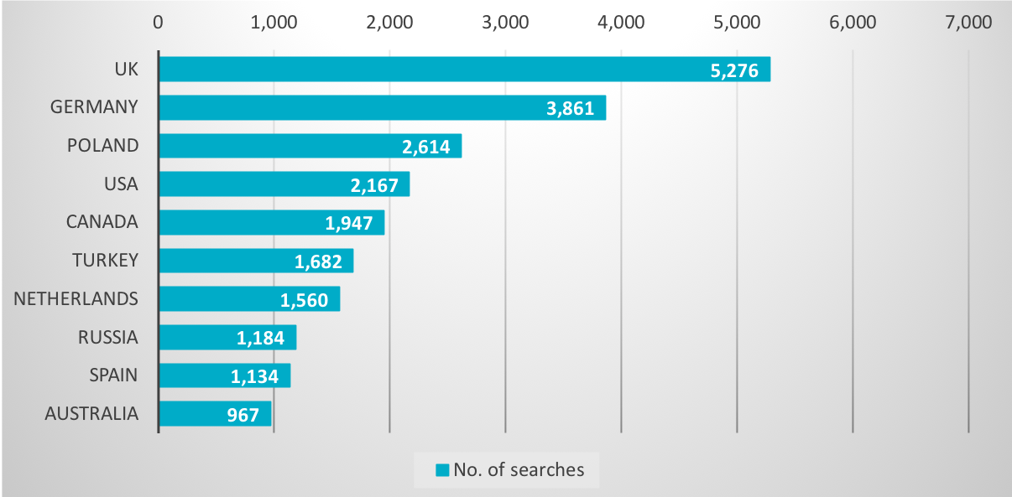
Unrelated donor/cord blood unit searches (country, top 10)
WMDA Search & Match Service 2022

Slide 12
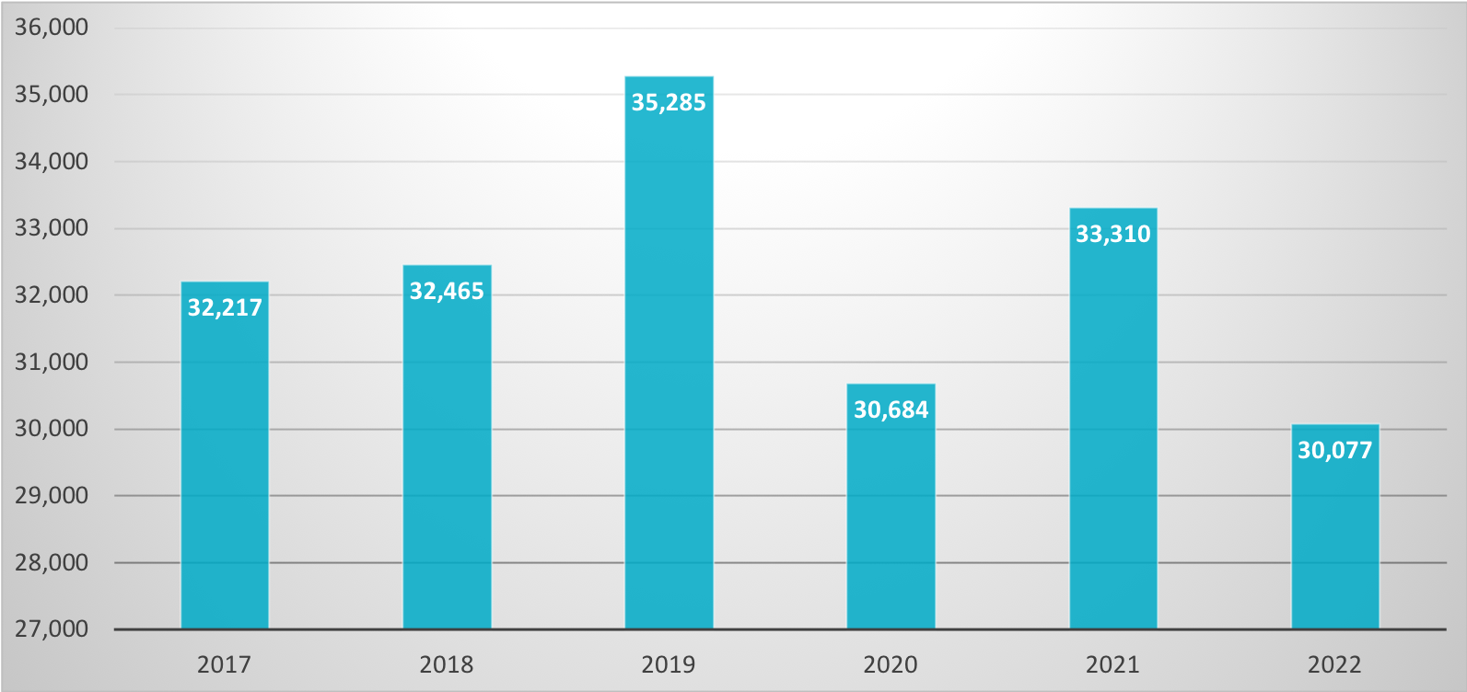
Unrelated donor / cord blood unit searches
WMDA Search & Match Service 2017-2022

Slide 13
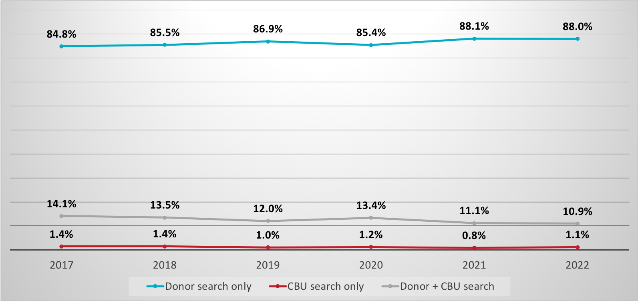
Search types
WMDA Search & Match Service 2017-2022

Slide 14
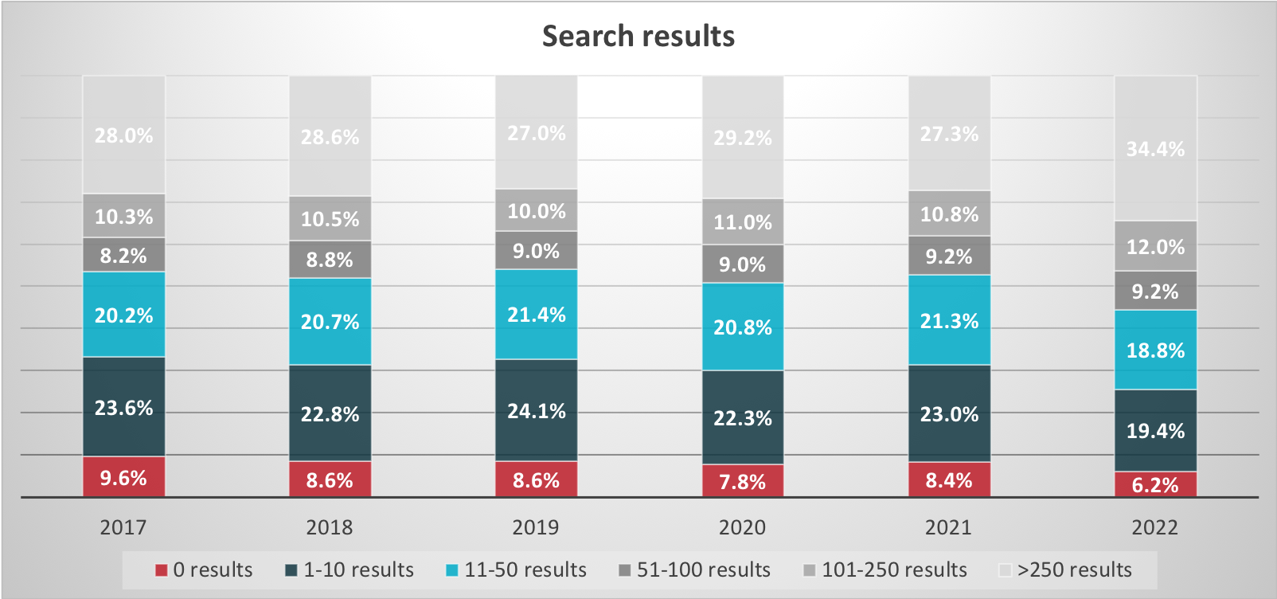
Search results
WMDA Search & Match Service 2017-2022

